Slide 1
M
O
R
N
I
N
G
C
A
R
P
O
O
L
Students are NOT to be dropped off in this area.
Student Drop Off Area
Bus Area

Slide 2
Morning Drop Off:
ALL car riders must be dropped off in the front of the school.
Due to safety concerns, students are not allowed to be dropped off on the street or in the bus area.
There are two lines for dropping off students. (One line in drive closest to the building and one between the two parking areas.) Do not move to middle line until motioned by duty teachers.
Students should walk around to the bus area to enter the school.
ANY student arriving to school after the tardy bell (7:10 a.m.) MUST be checked in at the front desk BY PARENT and receive an admit slip from the attendance clerk.
Vehicles must turn RIGHT ONLY when exiting the front parking lot.
Please be considerate of all parents dropping off children and not attempt to cut in line.
Please keep in mind that there are other vehicles moving through and parking during morning drop off.
Do not block the entrances to the parking area on Louise Street.

Slide 3
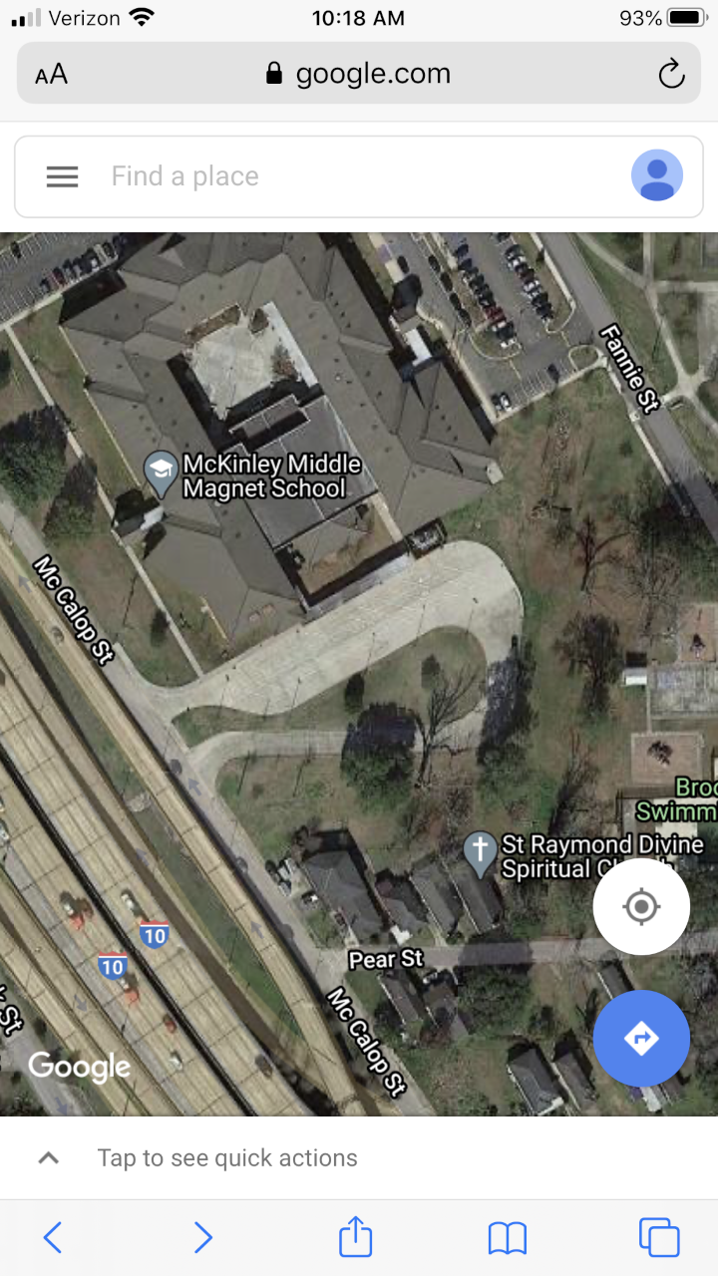




FRONT OF SCHOOL
EDDIE ROBINSON, SR. DRIVE
BUS
BUS
BUS
STOP
BUS
BUS
BUS
BUS
FORM SINGLE LINE SO BUSSES CAN PARK!!
DO NOT BLOCK DRIVEWAYS ON PEAR ST.

Slide 4
Afternoon Pick Up:
Carpool pick up takes place in the bus loading area (accessible via McCallop Street).
Parents should form a single line on the right side of the bus entrance.
Please keep in mind that the buses must enter and park in order for students to load their buses.
Once buses are loaded and dismissed, duty personnel will direct vehicles into the three pick-up lanes.
Please pull forward to allow more vehicles into the pick-up area.
Due to safety issues, parents are not allowed to walk to the carpool area to retrieve their child.
STUDENTS ARE NOT ALLOWED TO STEP OFF OF THE CURB UNTIL THE WHISTLE IS BLOWN THREE TIMES! Student safety is first. NO EXCEPTIONS!!!
Should your child not proceed to his/her vehicle, you will have to exit and return to the carpool line. We must keep the lines moving. (Please urge your child to pay attention and look for his/her ride. Cell phone use is allowed during afternoon carpool.)
Please follow instructions from the duty personnel directing traffic.
*DUE TO SAFETY REASONS, NO PARENT WILL BE ALLOWED TO EXIT THEIR VEHICLE TO RETRIEVE THEIR CHILD.

